Slide 1
UNIT II
LOGIC FAMILIES

Slide 2
Introduction
Logic families represent kind of digital circuit/ methodologies for logic expression.
Integration levels :
SSI: Small scale integration
MSI: Medium scale integration
LSI: Large scale integration
VLSI:Very large scale integration
12 gates/chip
100 gates/chip
1K gates/chip
10K gates/chip
ULSI:Ultra large scale integration
100K gates/chip
‹#›

Slide 3

Classification
Logic Family
Bipolar Logic Family
ULF(unipolar logic family)
Saturated
Non Saturated
PMOS(p-channel MOSFET) NMOS(n-channel MOSFET)
CMOS
RTL(resistor transistor logic)
Schottky TTL
DCTL(direct coupled transistor logic) IIL(integrated injection logic) DTL(diode transistor logic)
HTL(high threshold logic)
TTL(transistor transistor logic)
ECL(emitter coupled logic)
4

Slide 4

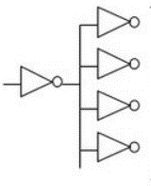
Fan In:
Fan in or gate is the number of inputs that can practically be supported without degrading practically input voltage level.
Fan Out:
The maximum number of digital input that the output of a single logic gate can feed and the gate must be same logic family.
Fan in = 4
Fan Out is calculated from the amount of current available in the output of a gate and the amount of current needed in each input of the connecting gate.
It is specified by manufacturer and is provided in the data sheet.
Exceeding the specified maximum load may cause a malfunction because the circuit will not be able supply the demanded power.
Fanout = 4

Slide 5
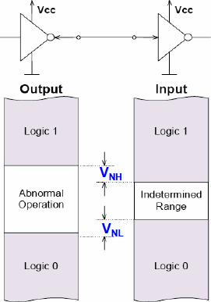
Noise Margin:
Noise is present in all real systems. This adds random fluctuations to voltages representing logic levels.
Hence, the voltage ranges defining the logic levels are more tightly constrained at the output of a gate than at the input.
Small amounts of noise will not affect the circuit. The maximum noise voltage that can be tolerated by a circuit is termed its noise immunity (noise Margin).

Slide 6
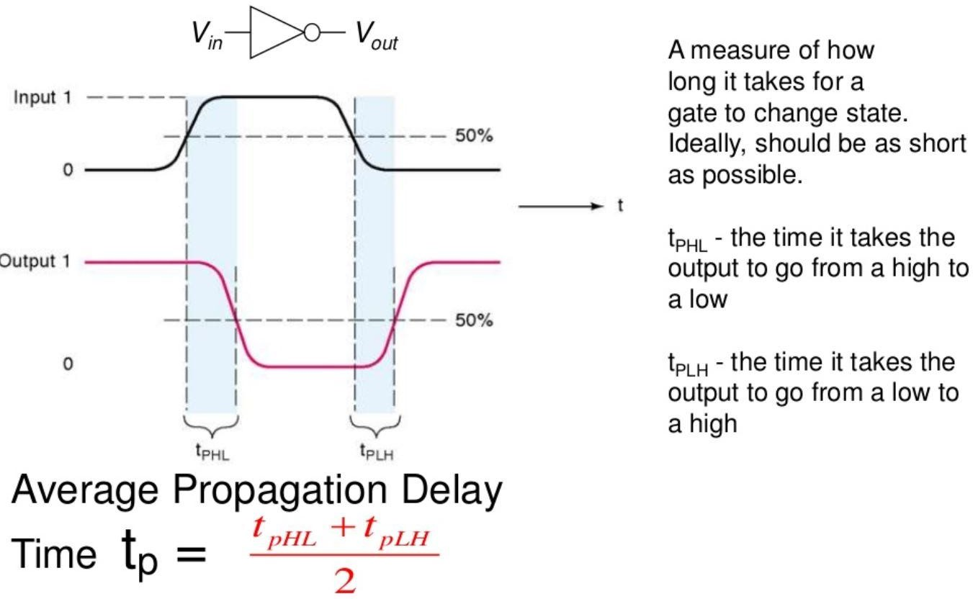
Propagation Delay

Slide 7
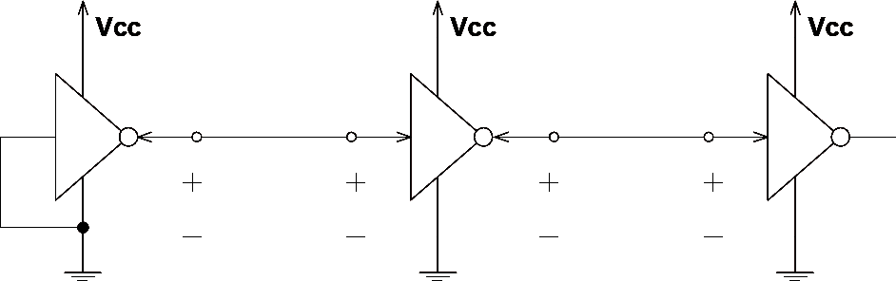
Logic families: V levels
V_{OH}(min) – The minimum voltage level at an output in the logical “1” state under defined load conditions
V_{OL}(max) – The maximum voltage level at an output in the logical “0” state under defined load conditions
V_{IH}(min) – The minimum voltage required at an input to be recognized as “1” logical state
V_{IL}(max) – The maximum voltage required at an input that still will be recognized as “0” logical state
^{V}OH
^{V}IH
^{V}OL
^{V}IL
‹#›

Slide 8
Logic families: I requirements
I_{OH} – Current flowing into an output in the logical “1” state under specified load conditions
I_{OL} – Current flowing into an output in the logical “0” state under specified load conditions
I_{IH} – Current flowing into an input when a specified HI level is applied to that input
I_{IL} – Current flowing into an input when a specified LO level is applied to that input
^{I}OH
^{I}IH
^{I}OL
^{I}IL
^{V}OH
^{V}IH
^{V}OL
^{V}IL
‹#›

Slide 9
Logic Families:
The types of digital circuit devices are classified in families that based on the specific circuit technology. Among them, the most important are TTL and CMOS
TTL (Transistor-Transistor Logic), made of bipolar transistors
It is called transistor–transistor logic because the logic function (e.g., AND) and amplification is performed by transistors
CMOS (Complementary Metal Oxide Semiconductor) made from MOSFET transistors
In the modern world, CMOS is the dominate technology used to construct digital circuit components, especially large-scale integrated circuits
The logic families differ from each other primarily in output current capability, power dissipation, propagation delay time, and operating power supply voltage
‹#›

Slide 10
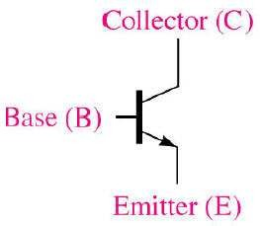
The Bipolar Junction Transistor
The bipolar junction transistor (BJT) is the active switching element used in all TTL circuit
The 3 terminals for a BJT are the collector, base, and emitter
BJT has 2 junctions: the base-emitter and the base- collector
The symbol for an npn BJT
‹#›

Slide 11
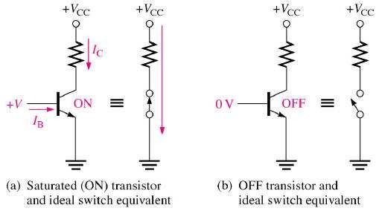
The Ideal Switching Action of the BJT
Consider a bipolar transistor in logic circuits
It is operated in either two states
It produces the two logic levels
Fully conducting state - saturated/turned on or
Fully non-conducting statecut-off state
‹#›

Slide 12
Transistor-Transistor Logic
In Transistor-Transistor logic or just TTL, logic gates are built only around transistors
TTL was developed in 1965
Through the years basic TTL has been improved to meet performance requirements. There are many versions or families of TTL. For example
Standard TTL
High Speed TTL (twice as fast, twice as much power)
Low Power TTL (1/10 the speed, 1/10 the power of “standard" TTL)
Schhottky TTL etc. (for high-frequency uses )
Here we will discuss only basic TTL. Typically, all TTL logic families have three configurations for outputs
Totem pole output
Open collector output
Tristate output
‹#›

Slide 13
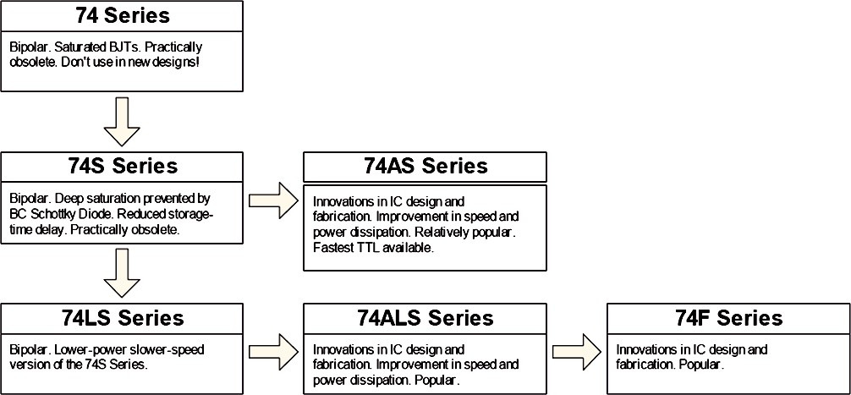
TTL family evolution
Legacy: don’t use in new designs
Widely used today

Slide 14

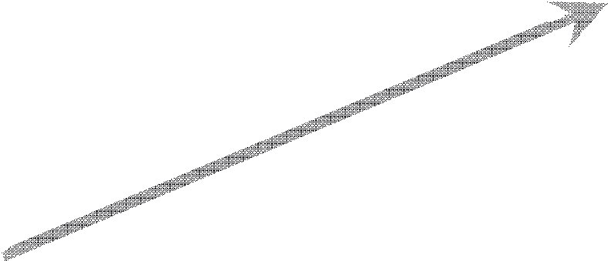

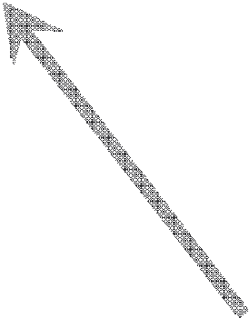
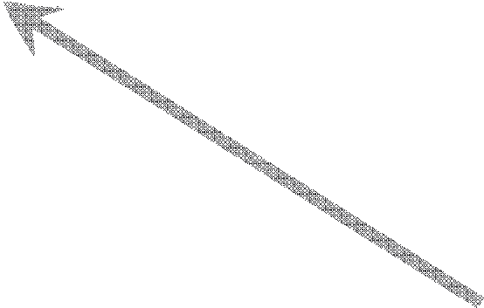
Part Numbers
Part numbers for 7400 TTL series logic devices often use the following naming convention
SN 74 ALS 245 A
package type, quality grade, etc. (varies widely by manufacturer)
manufacturer
SN = Texas Instruments DM = Fairchild
temperature range
74 - commercial
54 – military (extended)
logic subfamily
LS - Low Power Schottky AS - Advanced Schottky ALS - Advanced Low
Power Schottky
device
hundreds of different devices in each family
‹#›

Slide 15
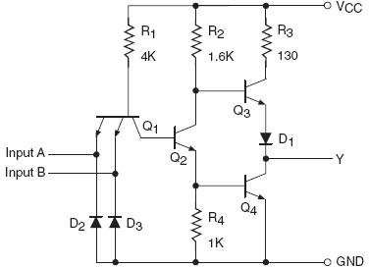
Totem Pole Output
Below is the circuit of a totem-pole NAND gate, which has got three stages
Input Stage
Phase Splitter Stage
Output Stage
Totem pole output stage
Standard TTL NAND gate
8

Slide 16
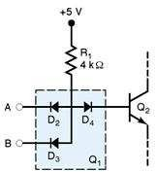
Totem Pole Output (Cont.)
Transistor Q1 is a two-emitter NPN transistor, which is equivalent to two NPN transistors with their base and emitter terminals tied together. The two emitters are the two inputs of the NAND gate
In TTL technology multiple emitter transistors are used for the input devices
Diodes D2 and D3 are protection diodes used to limit negative input voltages. When there is large negative voltage at input, the diode conducts and shorting it to the ground
diode equivalent for Q₁
KirtiP_Digital Design
9

Slide 17
Totem Pole Output (Cont.)
Q2 provides complementary voltages for the output transistors Q3 and Q4
The combination of Q3 and Q4 forms the output circuit often referred to as a totem pole arrangement (Q4 is stacked on top of Q3)
In such an arrangement, either Q3 or Q4 conducts at a time depending upon the logic status of the inputs
Diode D1 ensures that Q4 will turn off when Q2 is on (HIGH input)
The output Y is taken from the top of Q3

Slide 18
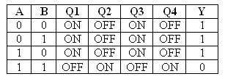
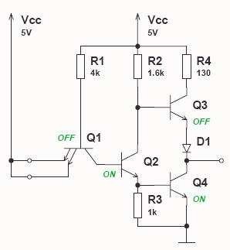
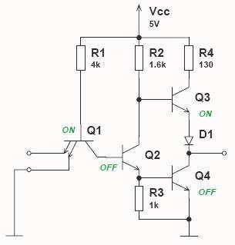
TTL Logic States Analysis
When a transistor is ON it acts like a closed switch and when a transistor is OFF it acts like an open switch
LOW output
HIGH output

Slide 19
Advantages of Totem Pole Output Configuration
The features of this arrangement are
Low power consumption
Fast switching
Low output impedance

Slide 20
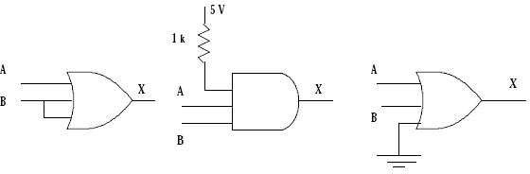
Unused Inputs on TTL devices
Unused inputs on TTL gates behave as though a logic 1 is connected to them
This present a problem with OR or NOR gates
With AND or NAND gates, the logic would not pose a problem but for better noise immunity, the inputs should not be allowed to "float“
It is advisable to connect unused HIGH inputs to +5V through resistors (“pull-up” resistors) of 1k
Unused inputs should be connected as follows

Slide 21
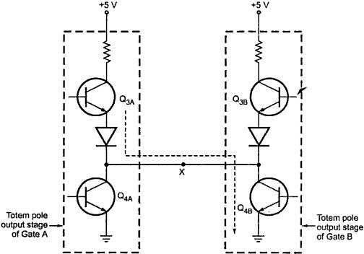
The Destruction Effect if Totem Pole Outputs are Tied Together
If TTL gates with totem-pole outputs have their outputs tied together, the gates may be destroyed
This is illustrated in below Figure where the LEFT gate has a HIGH output and RIGHT gate has a LOW output
Totem pole outputs tied
OFF
together can produce
harmful current throug ^{ON}
Q_{3A} and Q_{4B}
h
ON
OFF
KirtiP_Digital Design
15

Slide 22
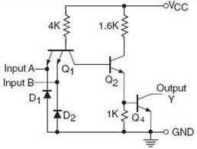
Open Collector Outputs
Figure below shows the circuit of a typical TTL gate with open-collector output
Observe here that the circuit elements associated with Q3 in the totem-pole circuit are missing and the collector of Q4 is left open-circuited, hence the name open-collector

Slide 23
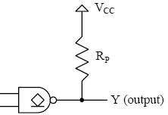
Open Collector Outputs (Cont.)
An open-collector output can present a logic LO output since there is no internal path from the output Y to t he supply voltage VCC , the circuit cannot present a logic HIGH on its own
To function properly an external pull-up resistor, R_{p} is being used as shown
Use this symbol to Indicate open collector output

Slide 24
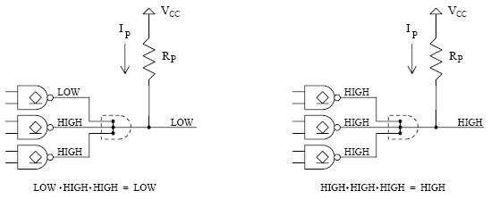
Advantages of Open Collector Outputs
Why should we use open-collector gates which require the addition of a pull-up resistor in order to function properly when we could use a gate with a totem-pole output instead?
There are several reasons:
Wired-ANDing - Open-collector outputs can be tied directly together which results in the logical ANDing of the outputs. Thus the equivalent of an AND gate can be formed by simply connecting the outputs

Slide 25
Advantages of Open Collector Outputs (Cont.)
Increased current levels - Standard TTL gates with totem-pole outputs can only provide a HIGH current output of 0.4 mA and a LOW current of 1.6 mA. Many open-collector gates have increased current ratings
Different voltage levels - A wide variety of output HIGH voltages can be achieved using open-collector gates. This is useful in interfacing different logic families that have different voltage and current level requirements
The big disadvantage of open-collector gates is their slow switching speed. This is because the value of pull-up resistor is in k, which results in a relatively long time constants

Slide 26
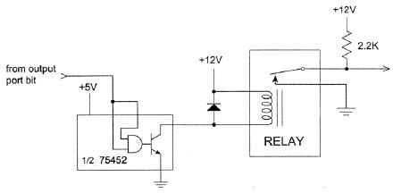
Directly Switch External Circuitry
An important characteristic of many open-collector output gates is that the output voltage doesn’t need to be a TTL level
The figure below shows a 75452 dual peripheral driver has a TTL AND gate as its input and a 30V, 300 mA open-collector transistor as its output, and can be used to interface a bit from a computer’s parallel port to a wide variety of external devices

Slide 27
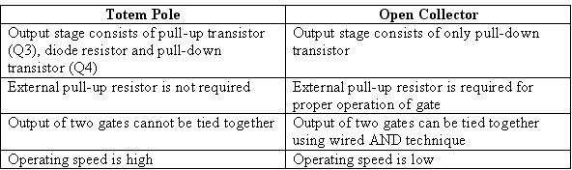
Comparison of Totem Pole and Open Collector Output
The major advantage of using a totem-pole connection is that it offers low-output impedance in both the HIGH and LOW output states

Slide 28
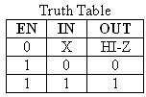
Tristate (Three-State) Logic Outputs
Tristate output combines the advantages of the totem-pole and open collector circuits
Three output states are HIGH, LOW, and high impedance (Hi-Z)
For the symbol and truth table, IN is the data input, and EN, the additional enable input for control
For EN = 0, regardless of the value on IN (denoted by X), the output value is Hi-Z
For EN = 1, the output value follows the input value
Variations:
Data input, IN, can be inverted
IN OUT
EN
This requires two inputs: input and enable
EN is to make output Hi-Z or
Control input, EN, can be inverted by addition o_{fo}f _{llow input} "bubbles" to signals

Slide 29
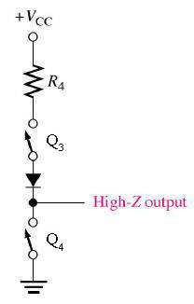
Hi-Impedance Outputs
Tristate gate utilize the high-speed operation of the totem-pole arrangement when input enabled
Permit outputs to be connected together
What is a Hi-Z value?
Both transistor are turned off in the totem- pole arrangement
This means that, looking back into the
circuit, the output appears to be disconnecte (open circuit)
d
An equivalent circuit for the tristate output in the high-Z state

Slide 30
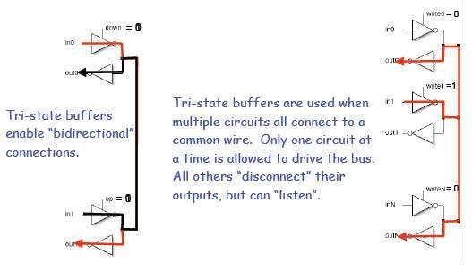
Use of Tri-state Buffers
A bus (a collection of wires that serve a common purpose) is created if several tristate devices are connected together
As long as only one is selected at a time, there is no problem
Kirti
24

Slide 31
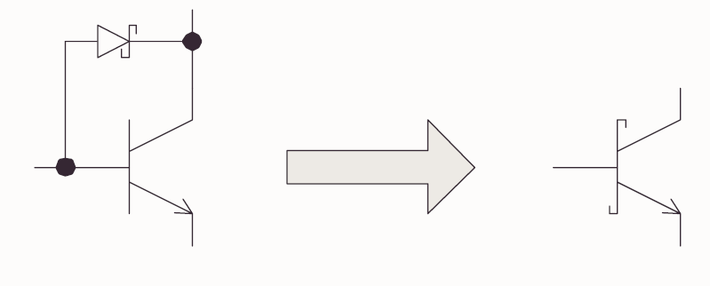
Schottky series (74LS00) TTL
A major slowdown factor in BJTs is due to transistors going in/out of saturation
Shottky diode has a lower forward bias (0.25V)
When BC junction would become forward biased, the Schottky diode bypasses the current preventing the transistor from going into saturation

